Slide 1


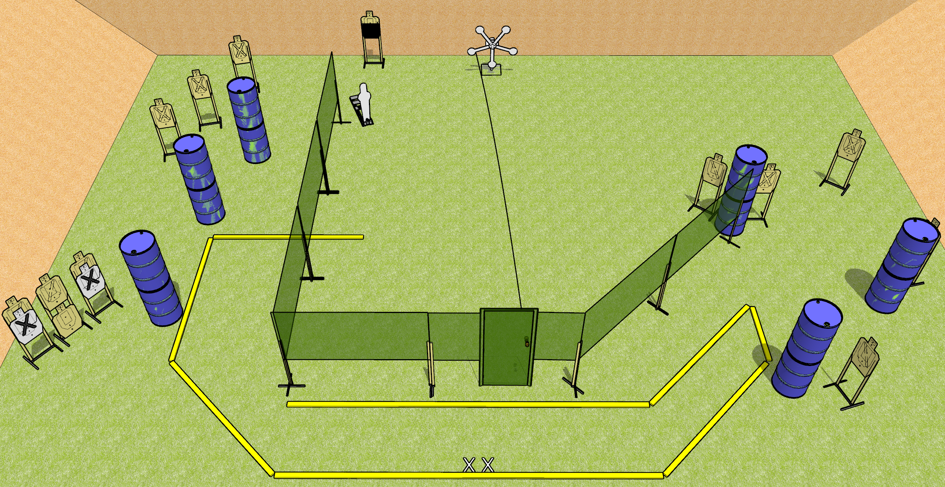
 | Dothan Gun Club – USPSA Match Keep on Spinning Course Designer : Drew Coleman
START POSITION : Standing with both feet on X’s
GUN READY CONDITION : Pistol loaded and holstered. PCC buttstock on belt, pointed in a safe direction. |  | SCORING: Comstock, 32 rounds TARGETS: 13 paper, 6 Steel SCORED HITS: Best 2 on paper, steel until down START-STOP: Audible, last shot RULES:
STAGE PROCEDURE: Engage targets as they become available from within the fault lines

Slide 2
The furthest right paper target should be able to be shot from near the door, but not be visible with the rest of the targets that are downrange of it
Left side rear targets – no more than two visible at once from the rear of the shooting area

